Slide 1
Lecture 3: THEORIES AND METHODS
SC22o5: Sociology of the family

Slide 2
Last week
Conceptualization of family ideology
Context of family ideology
Elements of family ideology

Slide 3
outline
What is a theory?
History of theory in the analysis of the family
Conceptual frameworks in the analysis of the family

Slide 4
What is a theory?

Slide 5
What is a theory?
A theory is a systematic collection of concepts and relations
Intellectual traditions
Focus and assumptions
Concepts
Propositions

Slide 6
What is a theory?
Every theory has an intellectual tradition
A general way of thinking that has been shared in common by a community of scholars
Every theory has a focus and a set of assumptions
Every theory represents a particular point of view
Assumptions are statements taken for granted as true and essential to the rest of the theory

Slide 7
What is a theory?
Every theory includes concepts
Concepts are the singular ideas that form the building blocks of a theory
Concepts may vary between cases and they may vary over time
Every theory includes propositions
Propositions are the statements that assert how concepts are related
Propositions take the form “If X, then Y”
Research methodology is the connection between propositions and the world of experience

Slide 8
History of theory

Slide 9
History of theory in the analysis of the family
1865-1890
Moral reformers address the declining importance of the family in the context of industrialization and urbanization
1890-1920
The idea that families could adapt to changing environments became popular
1920-1940
Shift from moral and political evaluations to empirical observation
R. L. Howard (1981) A Social History of American Family Sociology, 1865-1940

Slide 10
History of theory in the analysis of the family
1950-1966
Identifying conceptual frameworks but analysis was “amateurish, trivial, scattered, often sterile, and sometimes moralistic”
H. Christensen (1964) Handbook of Marriage and the Family
1967-1979
Applying the principles of deductive, propositional theory-building by philosophers and sociologists to various research areas
W. R Burr, R. Hill, F. I. Nye and I. Reiss (1979) Contemporary Theories about the Family (2 vols.)
National Council of Family Relations

Slide 11
History of theory in the analysis of the family
1980-present
Impact of feminist and ethnic minority theories and perspectives
Realization that family forms have changed dramatically
Greater multidisciplinary inclusiveness
More theoretical and methodological diversity
More concern with language and meaning
More constructivist and contextual approaches
Increased concern with ethics, values, and religion
A breakdown of the dichotomy between the private and public spheres
Greater recognition by family scholars of the contextual limits of family theory and research knowledge
W. Doherty, P. Boss, R. LaRossa, W. Schumm and S. Steinmetz (1993) Sourcebook of Family Theories and Methods: A Contextual Approach

Slide 12
conceptual frameworks

Slide 13
Kevin and Sarah have been dating seriously for about six months. Both agree that they have a close relationship with a lot of warmth and support. After going to a romantic movie, Kevin and Sarah go back to Kevin’s apartment. Sarah says, “Kevin, if we’re going to do it, I want you to use a condom. I have one in my bag.” Kevin says, “Gosh, honey, are you serious? Don’t you trust me? I mean, it’s not as though I have AIDS or something.” Sarah seems to be caught off guard and pauses for a moment before responding. “Kevin, I know how you feel about me, and I trust you, but a condom makes good sense because it is easy for anyone to pick up a sexually transmitted disease. Some of these diseases are hard to detect and even harder to cure, especially for women. I don’t want to end up not being able to have children when I am ready to as a result of carelessness.” Kevin quickly blurts, “But these things are so plastic. You know, Sarah, a guy doesn’t feel anything if he wears one of those!” Sarah’s voice carries a tinge of bitterness. “Kevin, I wanted to make love with you, but now I feel you are just after your own pleasure and don’t really care about the possible consequences for me. I am the one who gets pregnant, I am the one who has to get an abortion or carry the baby for nine months, and in the end, I am now the one who has to ask for commonsense preventive measure that would protect both of us.” Kevin’s tone now becomes disappointed but still angry. “Come on, and I will take you home.”

Slide 14
Social exchange framework: Intellectual traditions
Utilitarianism
A philosophical perspective that has heavily influenced exchange theories in the social sciences
Individuals weigh the rewards and costs associated with behavioral choices
They choose those activities that maximize their rewards

Slide 15
Social exchange framework: Focus and assumptions
Human beings are viewed as motivated out of self-interest
The focus is on the individual and what propels that individual to action
Exchange theory is based on the assumption of individual self-interest
Social scientists can understand an individual’s actions by understanding the individual’s interests and values
These interests allow the individual to account for both costs and rewards and make choices that maximize the individual’s profit
Rational actors choose a course of action that produces the greatest benefit

Slide 16
Social exchange framework: Concepts
Reward
Anything that is perceived as beneficial to an individual’s interest
Profit
Ratio of rewards to costs for any decision
Cost
Negative rewards
Rewards missed or forgone

Slide 17
Social exchange framework: Propositions
Individuals come together in groups so as to maximize their rewards
If the costs of group membership exceed the rewards of group membership, then membership in the group is no longer a rational choice
The family group is usually conceptualized as a source of rewards for individual members

Slide 18
Social exchange framework: Empirical application
In most cultures, sex seems more actively sought after by males than females
Nye (1979) argues that males are more likely to exchange rewards for sexual access
In most cultures, women take the major responsibility for the children they bear
Men for the most part report better outcomes from sex than do females
Relative to females, males find that sex offers greater rewards and fewer costs
As a result, men must increase the rewards for females
For example, marriage, money, status
W. R Burr, R. Hill, F. I. Nye and I. Reiss (1979) Contemporary Theories about the Family (2 vols.)

Slide 19
Nicole, Michael, and their teenage son, James, have agreed to participate in a social survey about family life. Survey officials requested that all three of them participate in answering questions. The doorbell rings and they meet the interviewer, a young woman named Kim. Kim asks that each of the family members fill out a section of the questionnaire independently of other members. James takes his questionnaire to his room, Michael fills his out in the kitchen, and Nicole completes hers in the living room, where Kim is waiting. After all three family members have completed their questionnaires, Kim briefly examines them. She then says, “Gosh, all three of you answered the question about how traditional or nontraditional your family is in very different ways. Would you folks mind discussing this with me for just a moment? We are supposed to discuss differences of opinion as part of the survey, and if you don’t mind, I’ll take notes occasionally.” The family agrees. It turns out that James believes his family is fairly traditional, Nicole believes the family is very traditional, and her husband, Michael, thinks the family is extremely nontraditional. Nicole says that she thinks the family is traditional because she feels she has to do all of the cleaning up after the “guys”. Michael says he thinks they are nontraditional because his mother never worked outside the home. He points out that his wife earns more money than he does. James believes they are fairly traditional because he has a mother and father that aren’t divorced. Finally, Michael asks Kim, the researcher, what the survey means by traditional. After the family is told the meaning, Kim asks if that information would change their answers. All three family members say, “Yes,” and that the survey meaning is not very close to what they think of as traditional.

Slide 20
Symbolic interaction framework: Intellectual traditions
George Herbert Mead and symbolic interactionism
By sharing common symbols, humans can adapt to and survive in their environment
The process by which infants come to acquire the symbol system of the society

Slide 21
Symbolic interaction framework: Intellectual traditions
Humans have the ability to mentally form associations
For example, when A is associated with B, we could say A is a sign for B
A sign is a necessary ingredient for the development of a symbol
A symbol is any sign that is agreed on by convention
The question symbolic interactionism poses is, “How do we agree upon the sign?”
For example, sounds such as “Dad”

Slide 22
Symbolic interaction framework: Focus and assumptions
The focus of symbolic interactionism is on the acquisition and generation of meaning
In the study of the family and other social groups, the assumption is that actors think and act according to the meanings they attribute to to their actions and context
For example, a toddler and a particular toy
Individuals are motivated to create meanings to help them make sense of their world
Individual’s motives are also constructed from the meanings available to the individual and relevant to the situation in which the individual is located

Slide 23
Symbolic interaction framework: Concepts
Role
Role taking
To put oneself in the place of the individual and includes the rules that the individual is expected to follow
The “place of an actor”
Notes:
Role
Although the concept of role does not originate with symbolic interactionism, it is one of the most basic concepts in symbolic interactionism
It is also the concept that has proved most problematic as Mead uses the term throughout his work but seemingly takes its definition as self-evident
A role is the “place of an actor”
Role taking then is to put oneself in the place of the individual, and it includes the rules that the individual is expected to follow

Slide 24
Symbolic interaction framework: propositions
For example, the general rule for a woman was to marry and bear children
The expectations that both the individual and others have about the performance of the role
The clarity of role expectations or rules of the role
Role strain where the individual does not have sufficient resources to enact a role or roles

Slide 25
Symbolic interaction framework: empirical application
Working mothers’ role strain
The greater the diversification of roles, the greater the role strain?
Voydanoff’s (1987) processual and dynamic approach to examining the relationship between employment and mother roles
There are various paths by which families may articulate the relationship between work and family roles and these change over time
For example, the demands of small children may be so great as to create role strain with most types of employment
As the children become more self-sufficient, maternal employment may have a constructive effect
Voydanoff, P. (1987) Work and Family Life

Slide 26
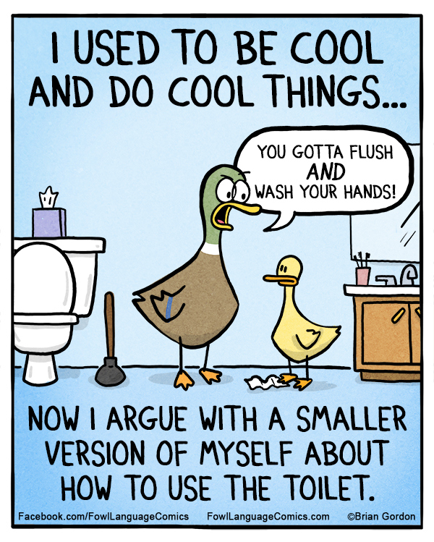

Slide 27
Family development framework: intellectual traditions
Descriptive phase
The family as having a life cycle
Systematizing phase
The family as composed of social roles and relationships that change with each new stage of the family
Ongoing, formal phase
Propositions and formal models

Slide 28
Family development framework: focus and assumptions
Family development theory focuses on the systematic and patterned changes experienced by families as they move through stages of their family life course
Incorporates time and history as major components
Time as measured by clocks, social process, and event histories
Microscopic changes in social roles in the family and macroscopic changes in the membership structure of the family

Slide 29
Family development framework: concepts
Family career
The concept of the family career superseded the earlier concept of family life cycle
A family career is composed of all the events and stages between events traversed by a family
Aldous (1978) conceptualized the family career as containing subcareers such as the sibling career, the marital career, and the parental career
Aldous, J. (1978) Family Careers.

Slide 30
Family development framework: concepts
Development tasks
An initial attempt to integrate age- and stage-graded social norms with the maturation of individual family members
Criticized as making non-scientific value judgements about what constitutes “success”
Redefined as a set of norms (role expectations) arising at a particular stage of the family career
Rodgers, R. H. (1973) Family Interaction and Transaction: The Developmental Approach.

Slide 31
Family development framework: Propositions
Family development is a process defined by social norms
Because norms are different from culture to culture, the process of family development may be different from culture to culture
For example, premarital birth in Singapore and in Polynesian culture
Social systems are viewed as defining the norms of family development
Social systems regulating the process of family development also change over historical time

Slide 32
Family development framework: empirical application
Transition to parenthood
Family development scholars have examined the stress attached to particular transitions in the family life course
Menaghan (1983) examined the stress associated with the transition to parenthood
The stress on individuals assuming the roles and norms of parenthood was alleviated by anticipatory socialization and coping skills
Menaghan, E. (1983) Marital Stress and Family Transitions: A Panel Analysis. Journal of Marriage and the Family, vol. 45, pp. 371-86.

Slide 33
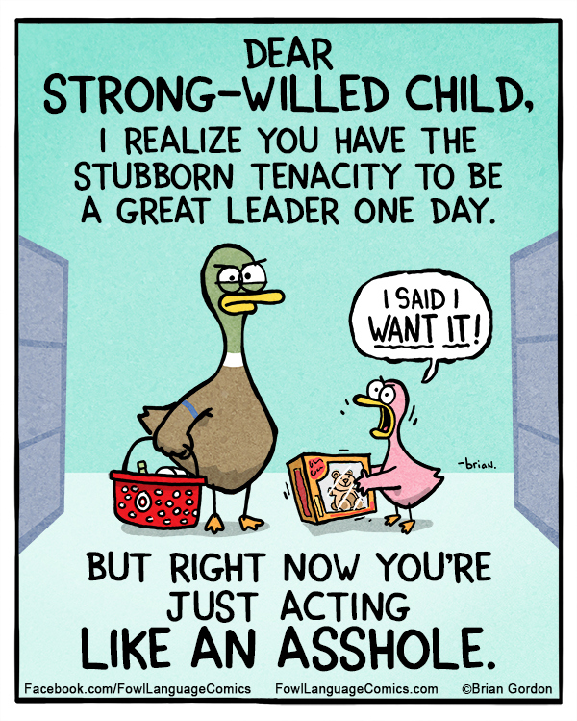

Slide 34
Conflict framework: intellectual traditions
Karl Marx
Humans are considered as essentially good rather than selfish and greedy
Because each individual or group must struggle to get a share of the scare goods and services that the society offers, it is society and its institutions that corrupt individuals
The struggle becomes divisive and ends with dominance of one group over others
Once in a position of power, the dominant group imposes its will on the remainder of society
Inequality is perpetuated through various social institutions
For example, the family transmits wealth and opportunity or poverty and lack of opportunity from one generation to another

Slide 35
Conflict framework: focus and assumptions
The focus of conflict theory is on both conflict within groups (family interaction) and conflict between groups (class conflict)
The assumption about scarcity of resources
If there were a surplus of resources, there would be no reason for them to pursue conflict

Slide 36
Conflict framework: concepts
Conflict
Conflict as a process is defined as “a confrontation between individuals, or groups, over scare resources, controversial means, incompatible goals, or combinations of these”
The existence of social order in the form of the state and laws does not mean that conflict is absent
Rather, conflict continues between interest groups and between individuals

Slide 37
Conflict framework: propositions
Conflict between groups (families) is based on resource allocation and competitive structure
There exists no known society in which resources are allocated equally to all
The fact that some families have more than others ensures competition
For example, debates over the definition of the family
Conflict within the group (the family) is due to the inequity of resources between individuals
Resources are differently allocated in a social system by age, gender, and group membership
As a result, resource differentials exist in the family
For example, females generally make less money than males

Slide 38
Conflict framework: Empirical applications
Domestic violence
Conflict theory predicts that confrontations occur when there is competition for scarce resources
Some feminist conflict scholars suggest that a patriarchal social system justifies and condones domestic violence as one form of women’s oppression
Men are defending their greater resources from women
Many of these resources are predicated on women “staying in their place”

Slide 39
Tessa and Rebecca are expecting their first child. They have just attended their first prenatal class and are driving home in their car discussing what they have learned. At one point in the class, the instructor asked the prospective parents to write down on a piece of paper three things that they thought about on hearing that they were to become parents. Tessa says to Rebecca, “You know, I was surprised that every one of the guys had thought of taking out life insurance or getting more life insurance!” She continued, “Some of those guys are barely shaving and a few must be around 50 years old. Yet they all said life insurance.” Rebecca replied, “I guess a really important part of being a father is still being a ‘provider’.” “Yeah,” said Tessa, “but what I was astounded by was that these guys are all different ages, races, and backgrounds, yet they all had similar ideas as to what becoming a father means.”

Slide 40
Structural-functional framework: intellectual traditions
Social Darwinism
Individuals are basically selfish and greedy
Social institutions must curb this greed and selfishness or society will not function smoothly
However, institutions also promote inequality
Because the resources of society were scare and individuals had to compete for them, only the strongest, the most intelligent, or those most willing to work would rise to positions of power and privilege
Ultimately, this would benefit society, for such individuals would provide enlightened leadership
Inequality is the price societies must pay to ensure peace and order

Slide 41
Structural-functional framework: focus and assumptions
Society is a complex system of interrelated parts
Each of which performs some function for the whole system
Structural functionalists are primarily interested in this relationship between structure and function
They seek to understand what various structures “do” for the larger system of which they are a part and the connections among the various structures

Slide 42
Structural-functional framework: concepts
Family
Sexual relationships among adults are regulated
Children are born, cared for, and socialized
Members are looked after
Members are provided an identity

Slide 43
Structural-functional framework: Propositions
Social institutions perform certain functions for a society
The institution of family means having certain legal and culturally recognizable rights and responsibilities, which are articulated in the formal laws of the state and informal norms of custom and tradition
For example, the Maintenance of Parents Act in Singapore
The institution of family also means having legitimate right to control or influence the lives of others
For example, the Compulsory Education Act in Singapore

Slide 44
Structural-functional framework: empirical applications
How individual behaviors are shaped by the structures in which they occur
Although individuals almost always have a choice of how to behave in specific situations, their choices are structurally laid out by society
For example, because individuals tend to marry partners of their social class, clear patterns have emerged in research on family life
Marriage stability reflect class and economics

Slide 45
Summary: Levels of analysis
Individual | Relationship | Family Group | Institution
Exchange | Symbolic Interaction | Family Development | Conflict
 |  |  | Family Development
 |  |  | Structural-Functional

Slide 46
How does the National Day Rally Speech challenge or reinforce the legitimacy and desirability of the “normal family”?
For discussion groups…

